Slide 1
Project Assignment
Face Recognition System: Application of Supervised Learning
Santosh Yadav Jada
16245773

Slide 2
AT&T Face database
This data base consists of 400 face images.
The subjects are 40 unique individuals with 10 images per subject.
Algorithm
We have used PCA algorithm for the face recognition system.
Software Used
MATLAB2017

Slide 3
Procedure:
Read the data
Take the mean of the data
Find the covariance
Find the eigen values and vectors
Sort the eigen values in descending order
Compute the feature matrix
Test the data
Compute the feature matrix for the test data
Use Euclidean classifier
Create labels
Use ezroc3 function

Slide 4
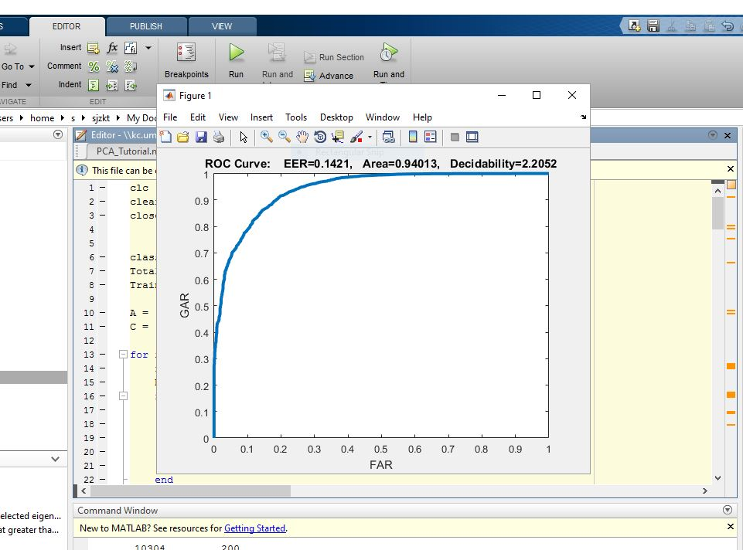
Mode 1

Slide 5
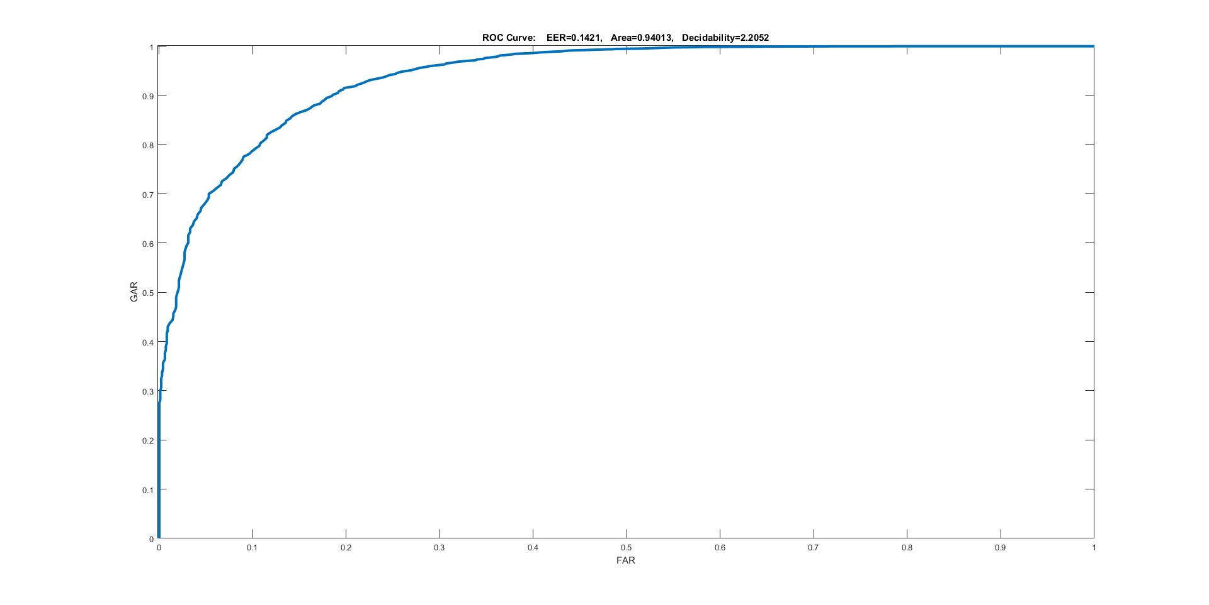
ROC curve

Slide 6
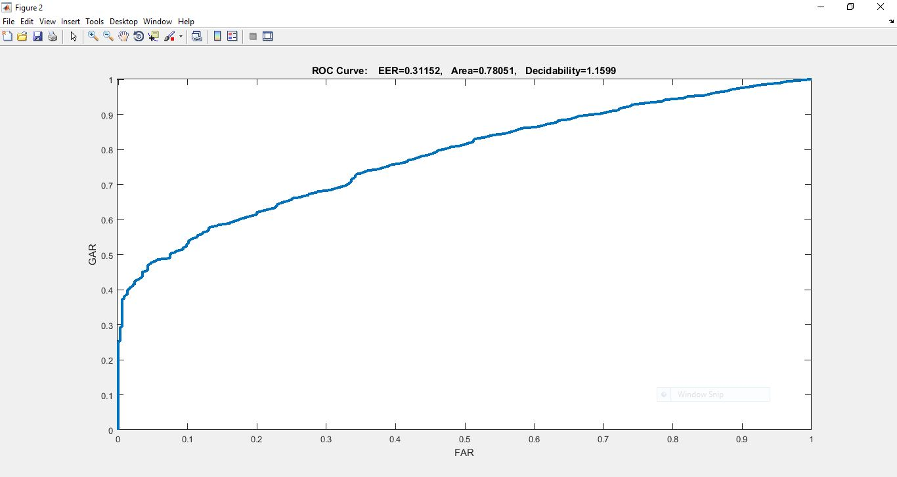
Mode 2 ROC curve

Slide 7
Performance Evaluation
Mode 1:
FRR value at 0% FAR : (1-GAR)=0.72
FRR value at 5% FAR : 0.35
FRR value at 10% FAR : 0.22
Mode 2:
FRR value at 0% FAR : (1-GAR)=0.75
FRR value at 5% FAR : 0.56
FRR value at 10% FAR : 0.48

Slide 8
Performance:
Accuracy is measured by the area under the ROC curve. Clearly from the ROC curves of two modes we understand that Mode 1 has better accuracy than Mode 2. Threshold shouldn’t be too be too low because false acceptance rate may increase. This we could infer from the ezroc function definition and the curve obtained.

